Slide 1

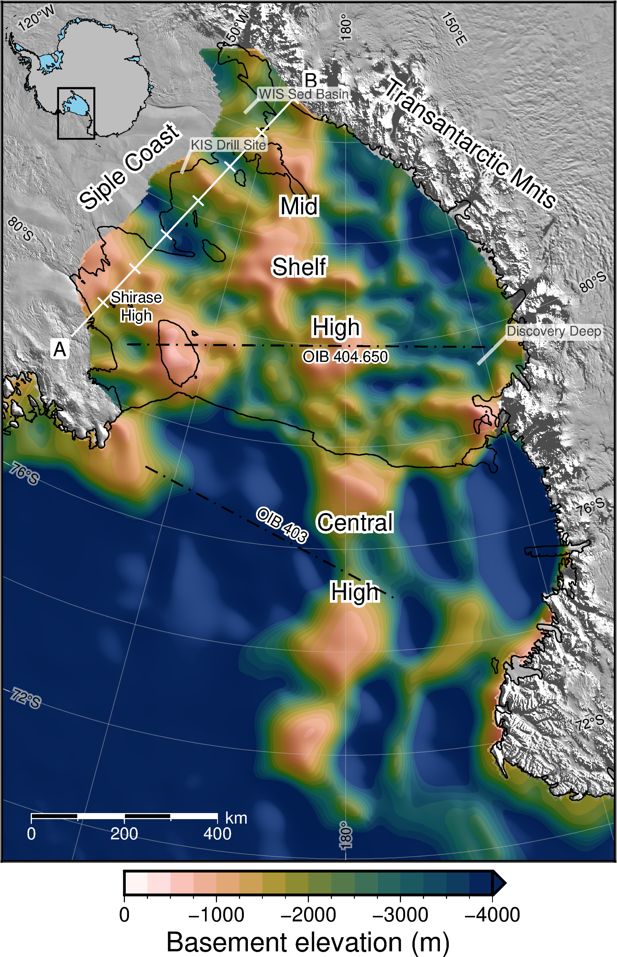
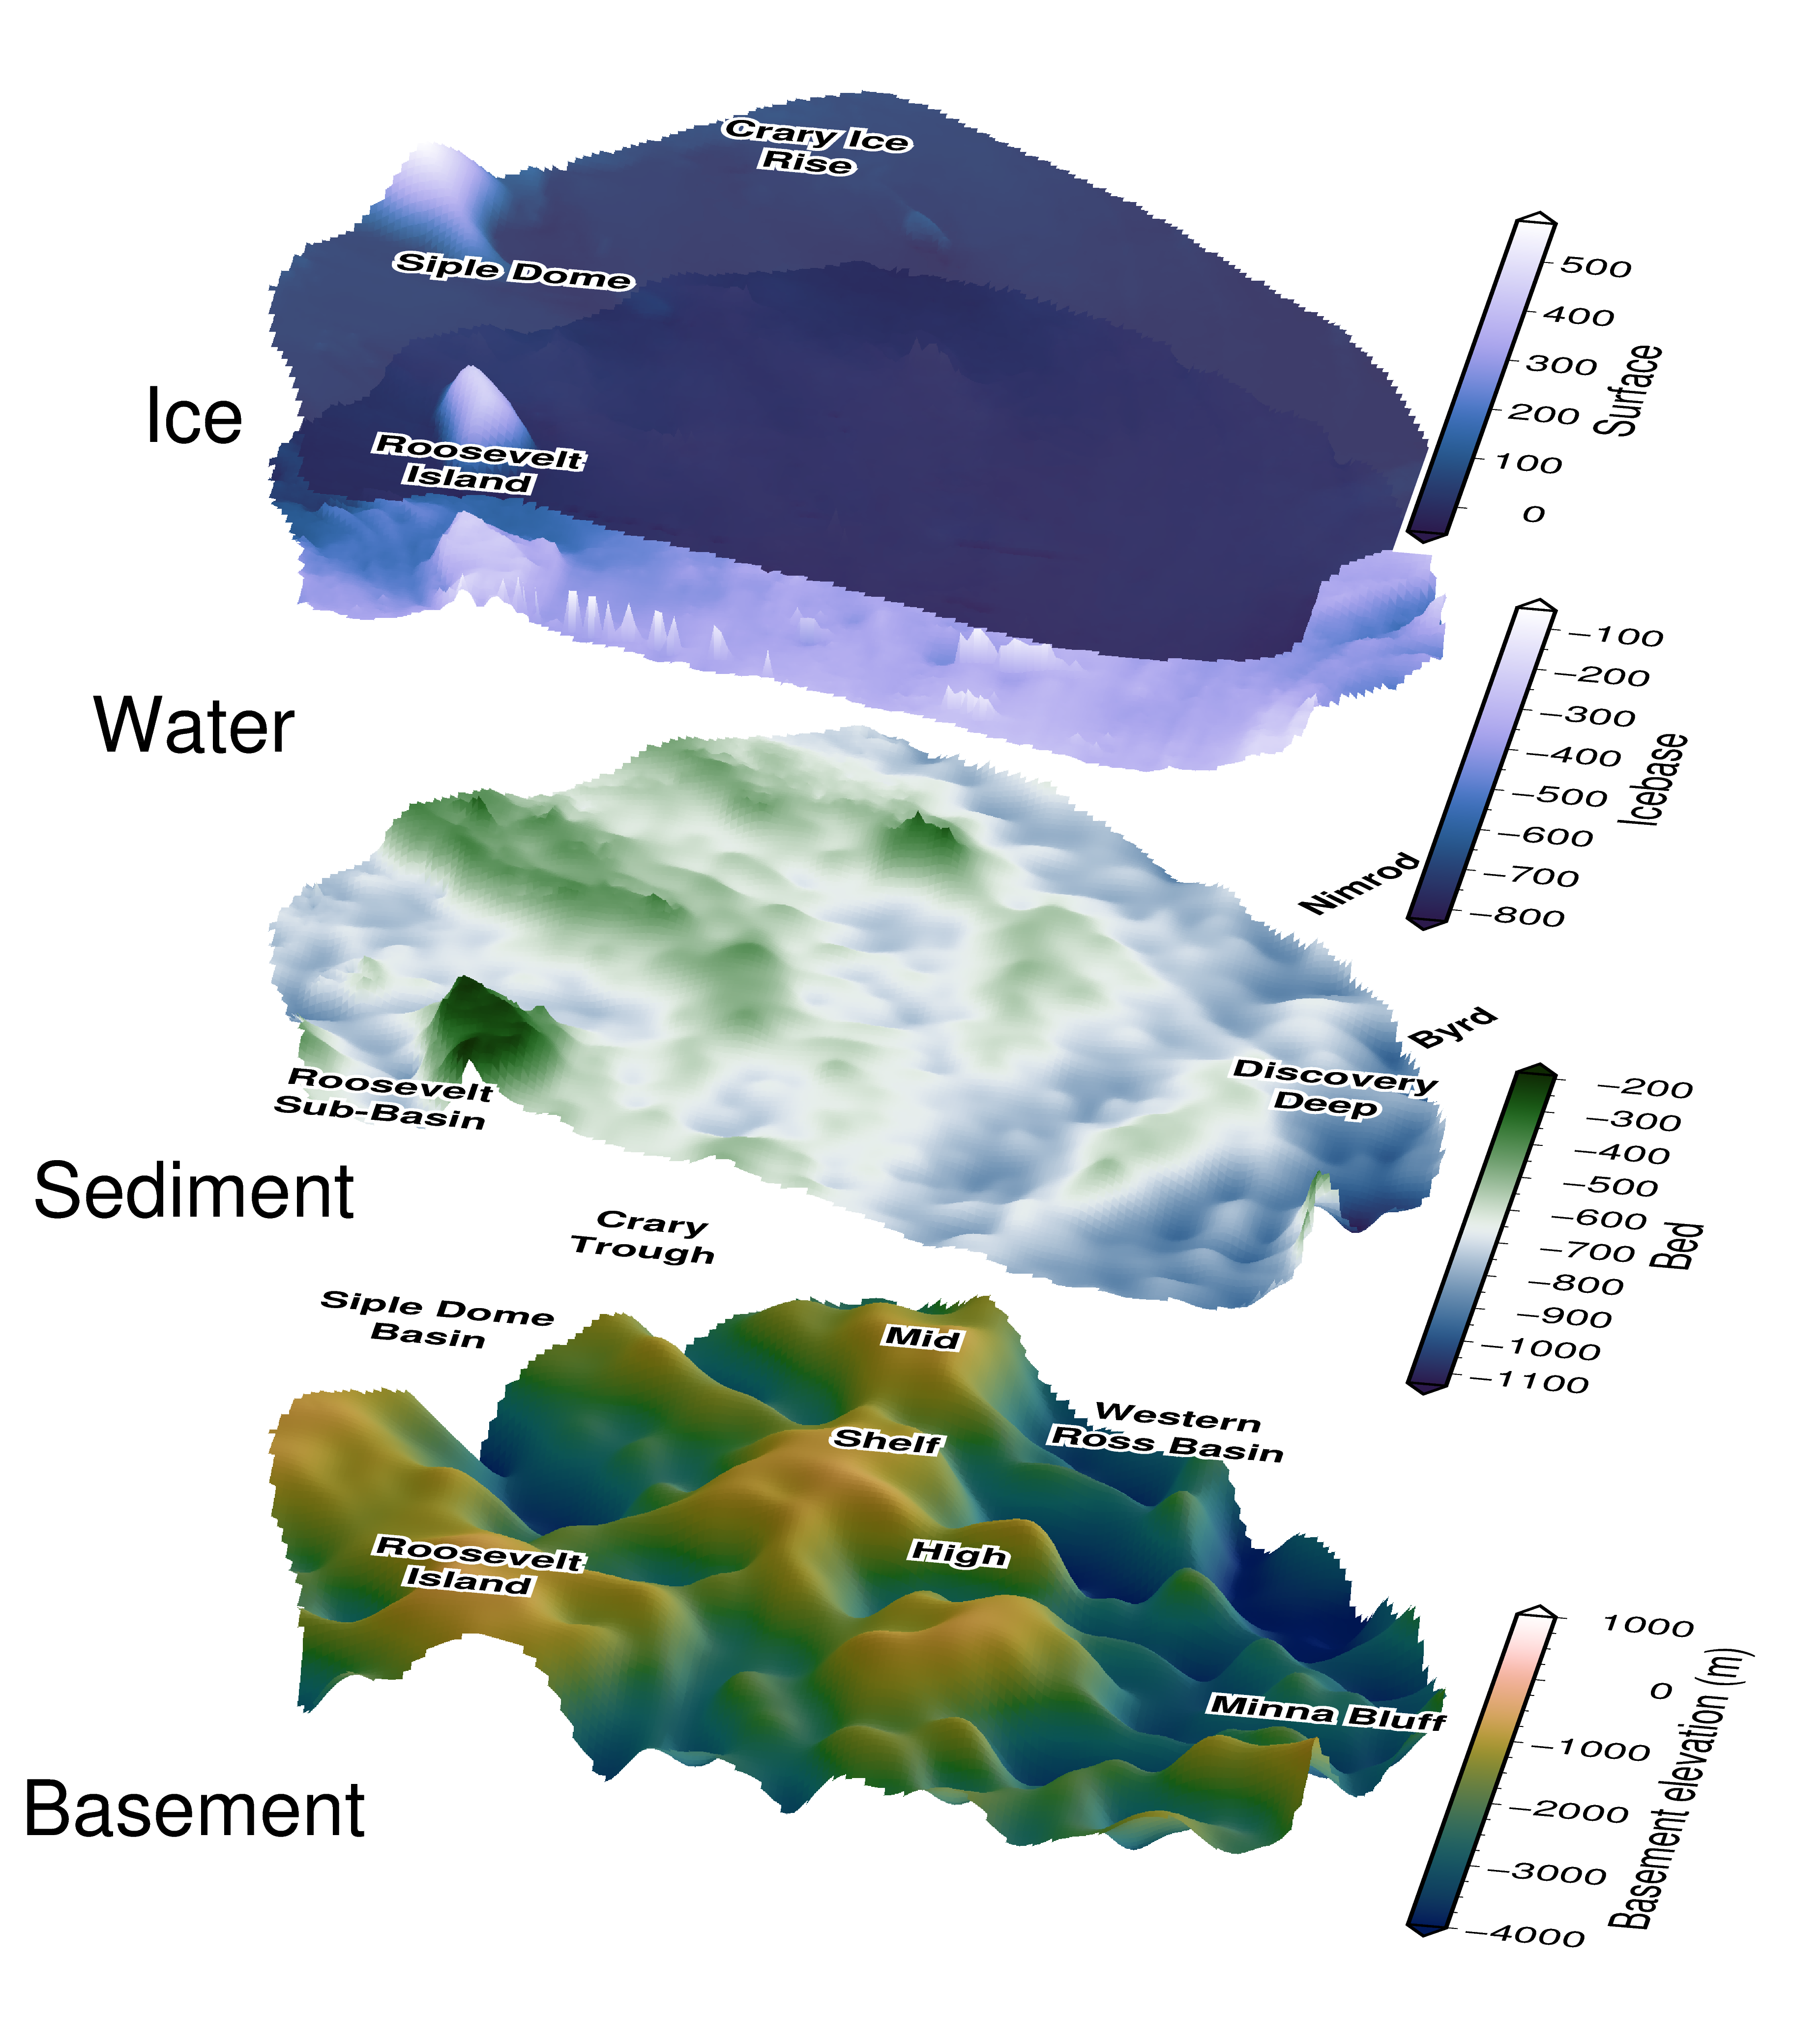
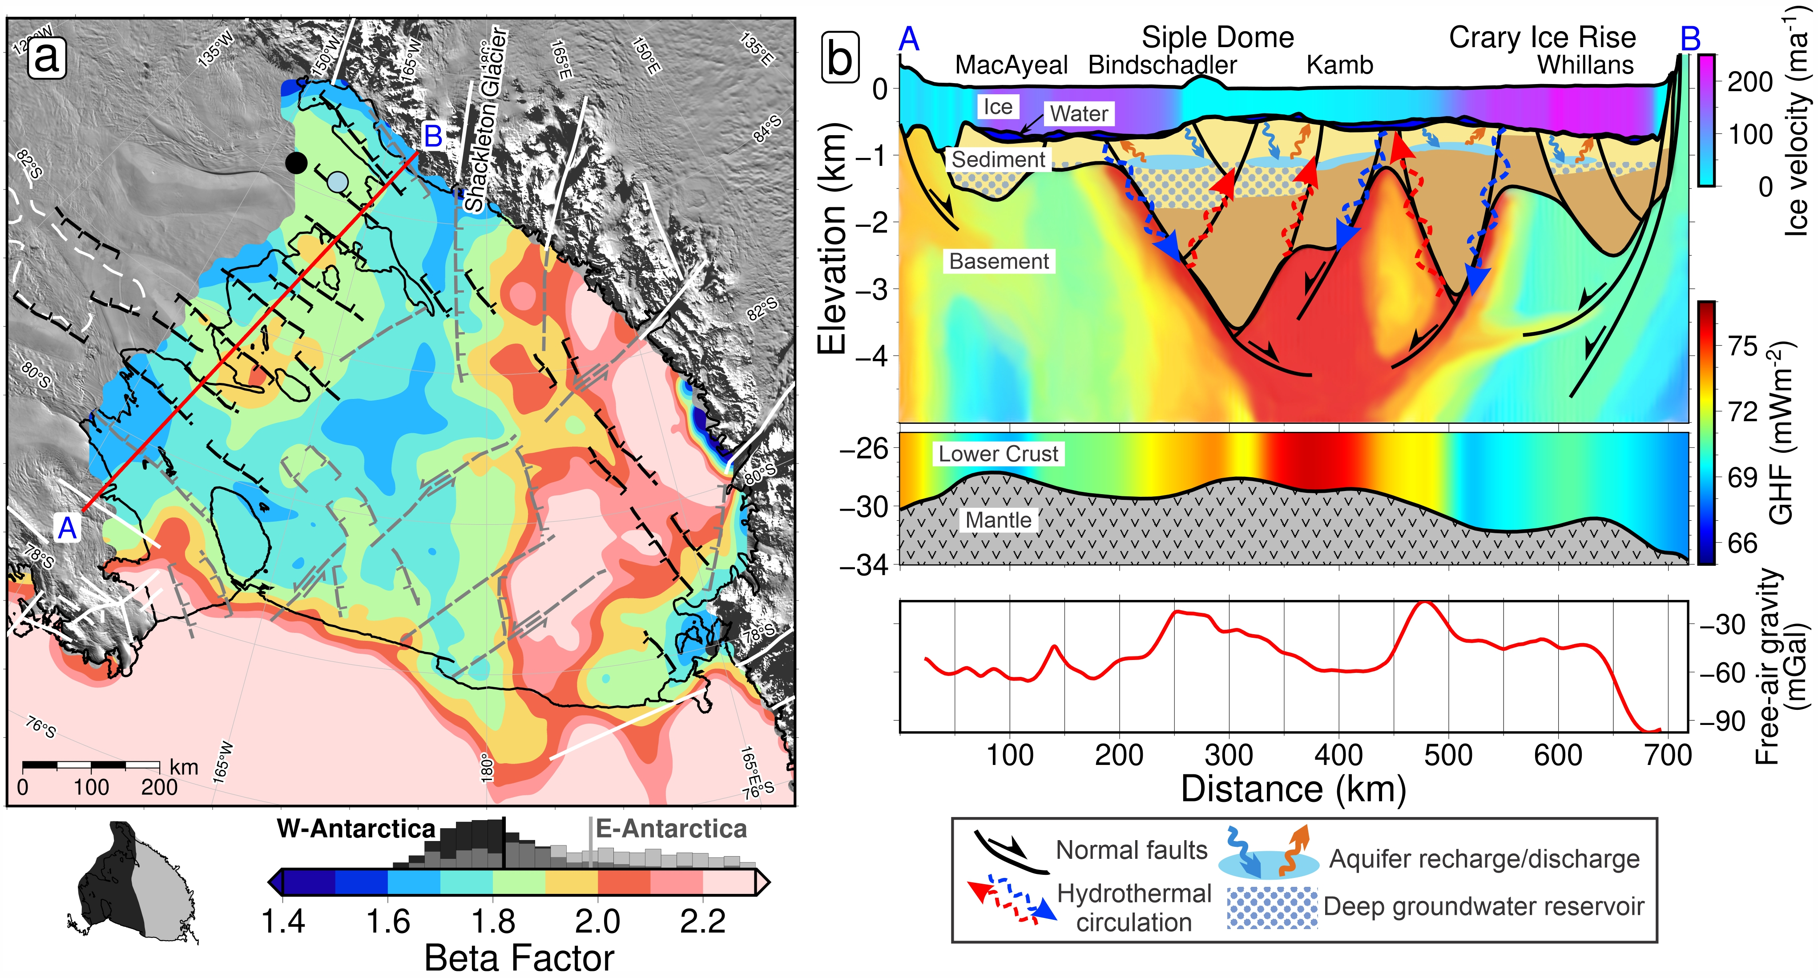
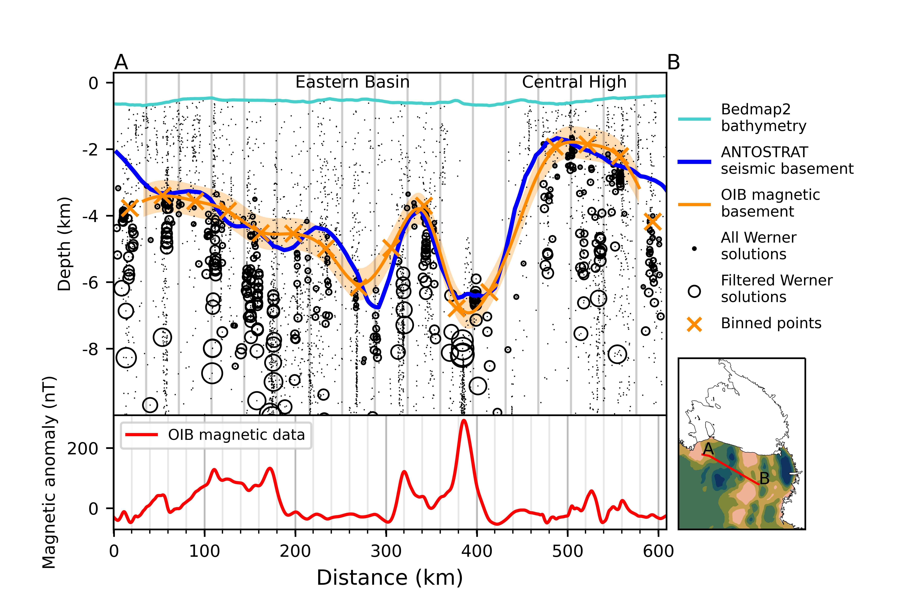
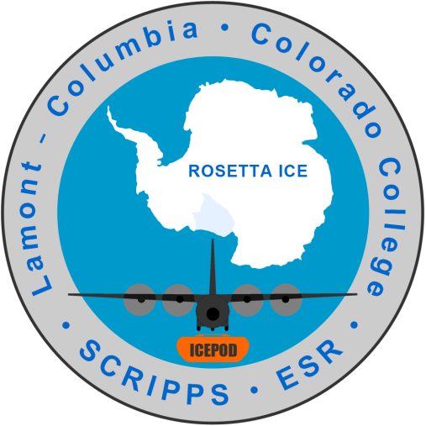






Revealing sub-ice shelf sediment basins with airborne magnetics
Matthew Tankersley^{1,2}, Huw Horgan¹, Christine Siddoway³, Fabio Caratori Tontini^{2,4}, Kirsty Tinto⁵ ¹Antarctic Research Centre, Victoria University of Wellington, NZ ²GNS Science, NZ ³Colorado College, USA ⁴University of Genova, Italy ⁵Lamont-Doherty Earth Observatory, USA
Introduction
Analysis of airborne magnetics data from the ROSETTA-Ice project reveals basement rock depths and sediment distribution beneath the Ross Ice Shelf (RIS). We use the resulting basement topography to highlight sites of possible influence upon the Antarctic Ice Sheet and to further understand the tectonic history of the region.
Methods
Werner deconvolution of airborne magnetic data used to map the contact between magnetic rocks (basement) and non-magnetic overlying sediments.
Developed the method in the Ross Sea with Operation Ice Bridge (OIB¹) aeromagnetics and ANTOSTRAT² seismic basement.
Used coincident OIB and ROSETTA-Ice³ lines to determine sub-RIS basement depths.
Merged RIS results with regional basement depths⁴.
Subtracted from bathymetry⁵ to get sediment thickness.
Results
Continuous drape of sediment, 50-3800m thick
Fault-bound basins from West Antarctic Rift System extension
Mid-Shelf High separates East/West Antarctic geology
East Ant. is deeper; distributed extension
West Ant. is shallower with linear, narrow, deep basins
Discussion
Narrow and deep basins along Siple Coast indicate active rifting
See Pollatsek et al. 2022 poster (this session)
Basin bounding faults could control GHF, groundwater transport, and GIA
Siple Coast basins likely contain voluminous groundwater
See Gustafson et al. 2022
Broad basement highs, likely locations for initialization of Oligocene ice
Siple Coast cross-section (A-B)
Ice surface, ice base, and bathymetry from Bedmachine⁵. Basement from this study. Moho from Shen et al. 2018⁶. Ice is colored by velocity⁷. Lower crust, between -25km and Moho, shows GHF model⁸ . Upper crust is theoretical GHF, guided by inferred fault locations
Ross Embayment basement elevations. Data under the RIS are from this study, while offshore data (below ~78°S) are from a regional compilation⁴, mostly ANTOSTRAT³. OIB¹ flights paths used for the tie are shown. A-B cross-section profile shown in white.
Check out the code at GitHub:
https://github.com/mdtanker/RIS_basement_sediment
References
1. Cochran et al. 2014, DOI: 10.5067/OY7C2Y61YSYW
2. Brancolini et al. 1995, DOI: 10.1002/9781118669013
3. Tinto et al. 2019, DOI: 10.1038/s41561-019-0370-2
4. Lindeque et al. 2016, DOI: 10.1002/2016GC006401
5. Morlighem et al. 2020, DOI: 10.1038/s41561-019-0510-8
6. Shen et al. 2018, DOI: 10.1029/2017JB015346
7. Mouginot et al. 2019, DOI: 10.1029/2019GL083826
8. Burton-Johnson et al. 2020, DOI: 10.5194/tc-2020-59
View the paper
https://doi.org/jdc2
Download the poster
https://doi.org/jdcz
Notes:
30 sec run through:
For this research we wanted to find out the thickness of the sediments beneath the Ross Ice Shelf, and then determine the shape of the basement rock surface underneath those sediments. We were able to do this using airborne magnetics data and some seismic constraints. Our results show a series of large sedimentary basin, with over 3km of sediments, as well as broad shallow basement ridges. We believe both of these features, either in the past, or currently, influence several important boundary conditions for the ice sheet.
Between the sediment basins, we find large basement highs with thin sedimentary cover. Some of these were likely above sea level mountain ranges during the initial phases of Antarctic glaciation and have thus influence the .

